Slide 1
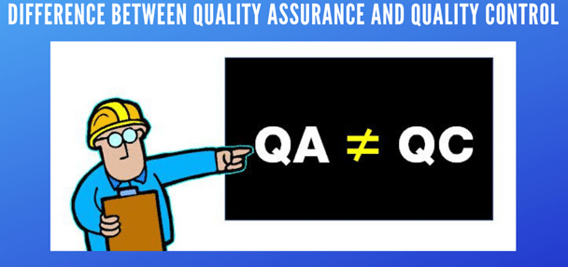

Slide 2
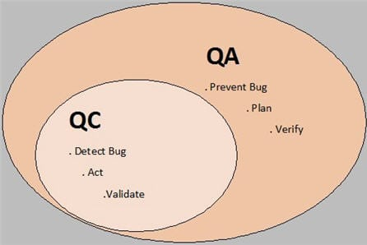
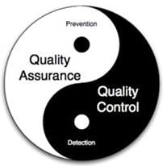

Slide 3
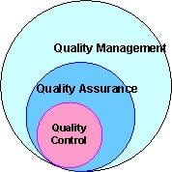
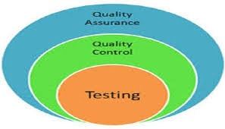

Slide 4
Real-life scenario Examples for QA/QC
QA Example:
Suppose a team has to work on completely new technology for an upcoming project. Team members are new to technology. So, we need to create a plan for getting the team members trained in the new technology.

Slide 5
Based on knowledge, we need to collect pre-requisites like DOU (Document of Understanding), design document, technical requirement document & functional requirement document and share these with the team.

Slide 6
This would be helpful while working on the new technology and even would be useful for any newcomer in the team. This collection & distribution of documentation and then initiating the training program is a part of the QA process.

Slide 7
QC Example:
Once the training is completed, how to sure that the training was successfully done for all the team members?
So, we have to collect statistics e.g. the number of marks the trainees got in each subject and the minimum number of marks expected after completing the training. Also, to ensure that everybody has taken training in full by verifying the attendance record of the candidates.

Slide 8
If the marks scored by candidates are up to the expectations of the trainer, then we can say that the training is successful otherwise we will have to improve our process in order to deliver high-quality training.

Slide 9
Another way to improve the training process would be collecting feedback from the trainees at the end of the training program. Their feedback will tell us what was good about the training and what are the areas where we can improve the quality of training.

Slide 10
Tools for Quality Control
1. Flowchart
Flowcharts are also used to document work process flows.
2. Check Sheet
A check sheet is a basic quality tool that is used to collect data. A check sheet is used to track the number of times a certain incident happens.

Slide 11
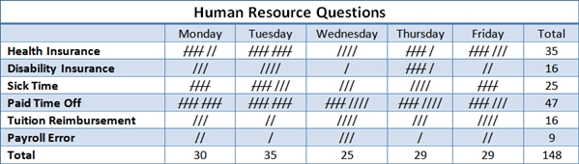
Example Check Sheet

Slide 12
3. Cause and Effect (fish bone) Diagram
A cause and effect diagram, also known as a fish-bone diagram shows the many possible causes of a problem.
To use this tool, we need to first identify the problem we are trying to solve and simply write it in the box (head of the fish) to the right.
Next, list the major causes of the problem on the spine of the fish.
Causes are typically separated into categories of people, process, materials and equipment.

Slide 13
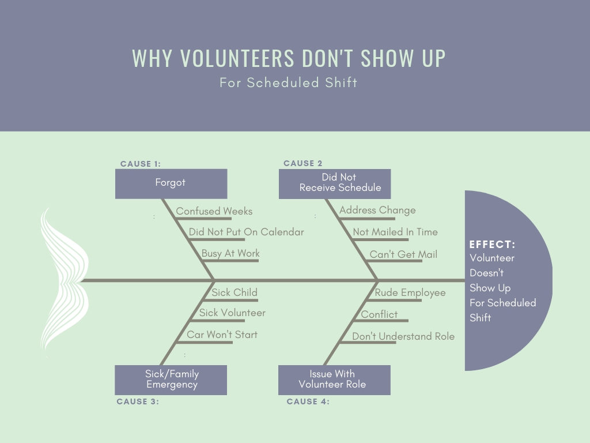

Slide 14
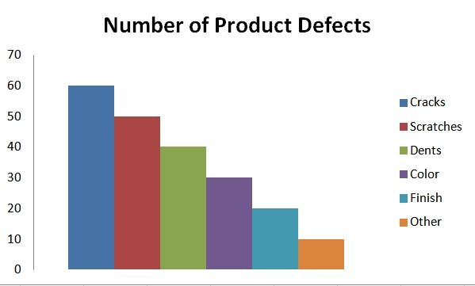
4. Pareto Chart
A Pareto chart is a bar graph of data showing the largest number of frequencies to the smallest.

Slide 15
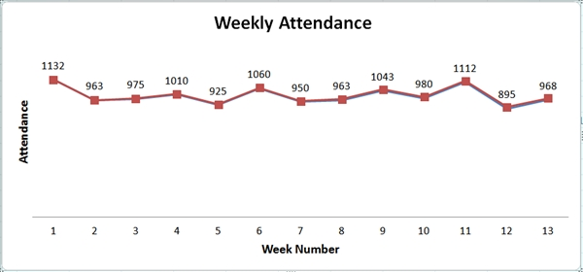
5. Control Charts
Control charts or run charts are used to plot data points over time and give a picture of the movement of that data.

Slide 16
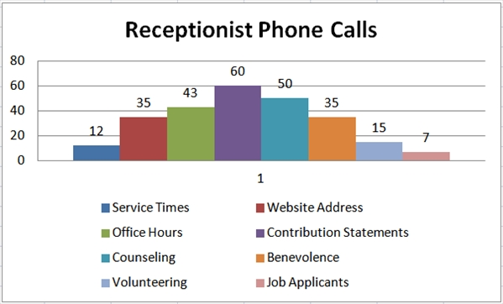
6. Histograms
Histograms are bar chart pictures of data that shows patterns that fall within typical process conditions.

Slide 17
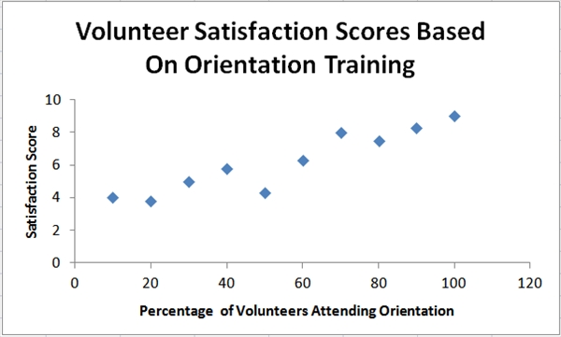
7. Scatter Diagrams
Scatter diagrams are graphs that show the relationship between variables. Variables often represent possible causes and effect.

Slide 18
Key Points:
In QA, processes are planned to evade the defects
QC agreements with the discovery of the defects and modifying them while making the product
QA detects weakness
QC detects defects

Slide 19
QA is process oriented
QC is product oriented
QA is a failure prevention system
QC is a failure detection system.

Slide 20
Affinity Diagrams
Affinity diagrams are used to organize large numbers of ideas for review and analysis. It is an excellent tool for organizing large amounts of data into meaningful groups by finding relationships between them
Tools and Techniques for the Perform Quality Assurance Process

Slide 21
Students Performance | Attendance statistic | Dedication/ Hardwork
Affinity Daigram

Slide 22
Process Decision Program Charts (PDPC)
It enables analysis of the incremental steps required, thereby facilitating identification of potential problems or pitfalls before they are encountered.

Slide 23
PDPC
Internal test Performance
Prelim Performance
Action
Final Semester Performance

Slide 24
Interrelationship Diagrams
An interrelationship diagraph is a visual display of the cause-and-effect relationships between multiple variables, complex problems, or desired outcomes.

Slide 25
Good Placement
Higher grade
Expertise increases

Slide 26
Tree Diagrams
Used to break down broad categories into finer and finer levels of detail, which helps move from generalities to specifics.
Prioritization Matrices
provide a mechanism for ranking the relative importance of ideas or issues.

Slide 27
Activity Network Diagrams
Used to show the output of techniques, such as :
Program evaluation and review technique (PERT),
critical path method (CPM),
Arrow diagramming method (ADM), &
Precedence diagramming method (PDM).

Slide 28
The network diagram is a schematic display of the logical relationships, or interdependencies, of all the project activities.
Because the diagram shows network logic, dependencies, and sequencing,
it is an effective tool to help plan the project.

Slide 29
Quality Assurance | Quality Control
It is a process which deliberates on providing assurance that quality request will be achieved. | QC is a process which deliberates on fulfilling the quality request.
QA is the technique of managing quality.. | QC is a method to verify quality.

Slide 30
QA Defines standards and methodologies to followed in order to meet the customer requirements. | QC ensures that the standards are followed while working on the product.
QA is the process to create the deliverables. Eg: SGPI | QC is the process to verify that deliverables. Eg: Grade status

Slide 31
QA is responsible for full software development life cycle. | QC is responsible for software testing life cycle.
QA means Planning for doing a process. Eg. Designing | QC Means Action for executing the planned process. Eg. Coding

Slide 32
Statistical Technique used on QA is known as Statistical Process Control (SPC.) | Statistical Technique used on QC is known as Statistical Quality Control (SQC.)
QA makes sure you are doing the right things. | QC makes sure the results of what is done is what is expected.

Slide 33
QA does not involve executing the program. | QC always involves executing the program.
All team members are responsible for QA. | Testing team is responsible for QC.
QA Example: Verification | QC Example: Validation.

Slide 34
Consider the following scenario: Eg................... Antivirus Application
When project is large
When releases are required to be frequent
When creation of a prototype is applicable
When risk and costs evaluation is important
When requirements are unclear and complex
When changes may require at any time
When long term project commitment is not feasible

Slide 35
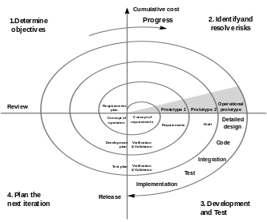

Slide 36
Example: let as take a Example of making a website of 7 pages for any shop.
This is a small website which is developed using a testing model and it require less time to developed .
1) Requirement Gathering and analysis :
All the client requirements about the website is gathered and prepare a SRS document. Requirements like their is
one registration page,
one login page,
user profile page,
products view page,
product buy,
add to cart ,
Billing.
All the requirements are clear, documented and well understood.

Slide 37
2) System Design : what type of programming language php, java or .net or what type of database is used to develop the website is planned in this phase.
3) Implementation : Once the programming language is finalized the coding starts in Implementation phase and small units are prepare like all the pages are coded one by one.
4) Testing: All the pages are integrated or linking with each other and performing system testing to check the functionality of the website it is according to the customer requirement or not.

Slide 38
5) Deployment:Once the website is completed it is deployed in the customer system for the acceptance .
6) Maintenance: If any issue comes after deploying the website then patches are released to resolve those issues.
Example: Let as take a Example for making a website for shopping mall which contains many shops.
Making a website for a shopping mall is not a easy task because it require lots of time. It is also not possible to gather all the requirements of all the shops at once .
So developing a Website for a mall the waterfall model is not appropriate.

Slide 39
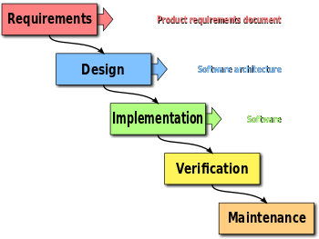

Slide 40
Consider a scenario: Eg…………………………
Requirements of the complete system are clearly defined and understood.
Some details may evolve with time.
Need to get a product to the market early.
A new technology is being used
Resources with needed skill set are not available
There are some high risk features and goals.

Slide 41
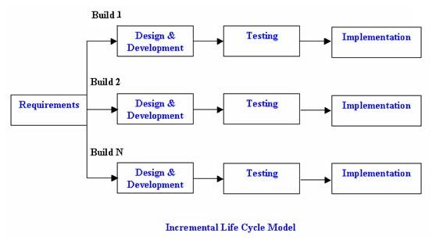

Slide 42
Consider a Scenario:
Establish few initial requirements
Design
Develop
Test
Deploy
Evaluate the resulting micro outcome (ie a product feature)
Collect feedback on what’s been presented thus far
Establish new requirements for next sprint based on feedback & repeat the micro outcome cycles until you achieve the final desired product
Eg………………………………………………

Slide 43
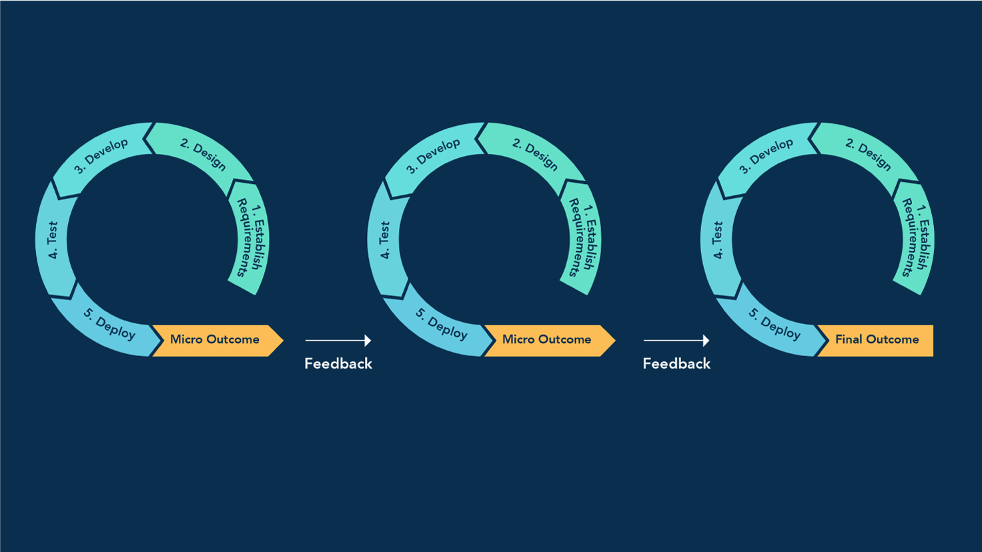

Slide 44
What Projects Are a Better Fit for Agile?
There are several factors that can make a project a better fit for agile over waterfall. These include:
Unclear requirements/deliverables
Level of participation/input from customers
Cost of change is minimal
Emphasis on teamwork, transparency and continuous improvement
B Div 26th June

Slide 45
Test Case Development
Test Case ID |  | 456 | Test Case Description |  | Test the Login Functionality
Created By |  | ASHISH | Reviewed By |  | GIRISH |  | Version |  | 4.5
QA Tester’s Log |  | Review comments from XYZ incorprate in version 4.5
Tester's Name |  | Ashish | Date Tested |  | June 27, 2019 |  | Test Case (Pass/Fail/Not Executed) |  | Pass
S # | Prerequisites: |  |  |  | S # | Test Data
1 | Access to Mozilla Browser |  |  |  | 1 | Userid = abc456
2 |  |  |  |  | 2 | Pass = abc456
Test Scenario | Verify on entering valid userid and password, the customer can login
Step # | Step Details |  | Expected Results |  | Actual Results |  |  | Pass / Fail / Not executed / Suspended
1 | Navigate to http://facebook.com |  | Site should open |  | As Expected |  |  | Pass
2 | Enter Userid & Password |  | Credential can be entered |  | As Expected |  |  | Pass
3 | Click Submit |  | User is logged in |  | As Expected |  |  | Pass

Slide 46
Test Scenario ID |  | Login-1 |  |  | Test Case ID | Login-1B
Test Case Description |  | Login – Negative test case |  |  | Test Priority | High
Pre-Requisite |  | NA |  |  | Post-Requisite | NA
Test Execution Steps:
S.No | Action |  | Inputs | Expected Output |  | Actual Output | Test Browser |  | Test Result | Test Comments
1 | Launch application |  | https://www.facebook.com/ | Facebook home |  | Facebook home | IE -11 |  | Pass | Launch successful
2 | Enter invalid Email & any Password and hit login button |  | Email id : invalid@xyz.com Password: ****** | The email address or phone number that you've entered doesn't match any account. Sign up for an account. |  | The email address or phone number that you've entered doesn't match any account. Sign up for an account. | IE -11 |  | Pass | Invalid login attempt stopped
3

Slide 47
Action |  | Inputs | Expected Output | Actual Output | Test Browser | Test Result | Test Comments
Enter valid Email & incorrect Password and hit login button | Email id : valid@xyz.com Password: ****** | The password that you've entered is incorrect. Forgotten password? | The password that you've entered is incorrect. Forgotten password? | IE -11 | Pass | Invalid login attempt stopped

Slide 48
Que: What are the data points you should add while writing a good test case?
Ans. Following are the qualities that constitute a good test case.
1. Test case ID 2. Test description 3. Priority
4. Environment 5. Product version 6. Steps required
7. Expected output 8. Actual output

Slide 49
Que: What is Negative Testing and how is it different from Positive Testing?
Ans.
1. Negative Testing is an approach to find how does the system behave with invalid inputs.
It ensures that the application shows correct error codes or messages. And the system does not crash on feeding invalid data.

Slide 50
2. Negative Testing differs from the Positive Testing in the sense as the latter confirms the system works as expected. Whereas the Negative Testing does the opposite.
It is for making sure that the system would work even if a novice handles it without prior knowledge

Slide 51
“V" Model: Principles
1: Large to Small: Requirements Definition, High-Level Design, and Detailed Design phases
2: Data/Process Integrity: incorporation and cohesion of both data and process
3: Scalability: The "V" concept is as applicable to a large mainframe development project applying a waterfall approach as it is to a web-based development project applying agile techniques.

Slide 52
4: Cross Referencing: This principle states that there must be a direct correlation between every requirement that has been defined with a corresponding and verifiable testing activity.
5: Tangible Documentation: This principle states that there must be tangible documentation (electronic and/or hardcopy) created as the project evolves.

Slide 53
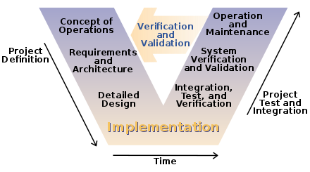

Slide 54
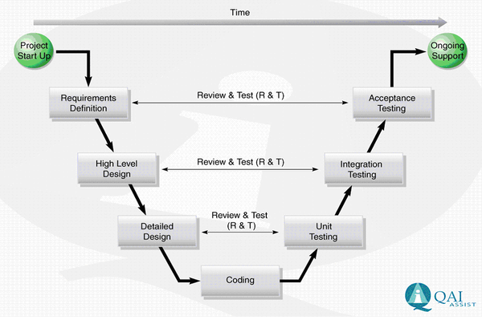
VERIFICATION PHASE VALIDATION PHASE

Slide 55
Que: What are the different verification techniques available for QA?
Ans. Verification is static type of s/w testing. It means code is not executed. The product is evaluated by going through the code. Types of verification are: i. Walkthrough ii. Inspection iii. Reviews

Slide 56
Walkthroughs :
are informal , They are usually unplanned.
Author explains the product;
colleague comes out with observations and
author notes down relevant points and takes corrective actions.

Slide 57
Inspection is a thorough word-by-word checking of a software product with the intention of: - Locating defects - Confirming traceability of relevant requirements - Checking for conformance to relevant standards and conventions

Slide 58
Inspections are more formal than walkthroughs.
It involves 5 major roles: - Author: CREATOR - Moderator: CONFORMANCE - Reader: Logical Units - Recorder: ------------- - Inspector: Analyzer

Slide 59
Review is a subsequent examination of a product for the purpose of monitoring earlier changes. determine the degree to which stated objectives have been reached. There are four levels : 1. Component Testing: 2. Integration Testing: 3. System Testing: 4. Acceptance Testing:

Slide 60
Think Question: ??????
Que: Mention static testing techniques and Dynamic testing techniques for :
Development of Product Website
Development of Anti virus

Slide 61
Examination Question :
Que: Discuss V & V in the different phases of Development life cycle:
Planning; Requirement; Design; Implementation; Test; Installation & Checkout; Operation ; Maintenance.
Hint: Concept docu; Interface-test plan- acceptance plan;
Integration-Component test; Source code-test cases;
Test case execution-Risk analysis; test report;
Change proposed; Migration-Production issues.

Slide 62
Que. What are the tools used by a tester while testing?
Selenium
Firebug : Firebug mainly allows its users to debug, edit and monitor of any website’s CSS, HTML, DOM and JavaScript. It also features a Java Script console for logging errors and watching values, as well as a “Net” feature which monitors the amount of time in milliseconds it takes to execute scripts and load images on the page.

Slide 63
OpenSTA : Open System Testing Architecture - a distributed software testing architecture designed around CORBA.
WinSCP: WinSCP is an open source free SFTP client, SCP client, FTPS client and FTP client for Windows. Its main function is file transfer between a local and a remote computer.

Slide 64
YSlow for FireBug : YSlow analyzes web pages and suggests ways to improve their performance based on a set of rules
Web Developer toolbar for firefox :

